Slide 1
TRASH HATE
Lucien

Slide 2
TRASH HATE
THERE'S TOO MUCH HATE IN THIS WORLD. TAKE THE ORLANDO INCIDENT FOR EXAMPLE, MORE THAN TWO HUNDRED PEOPLE GOT MURDERED. IT WAS A NIGHTMARE. HATE IS MAKING THIS WORLD DARK AND MISERABLE.

Slide 3
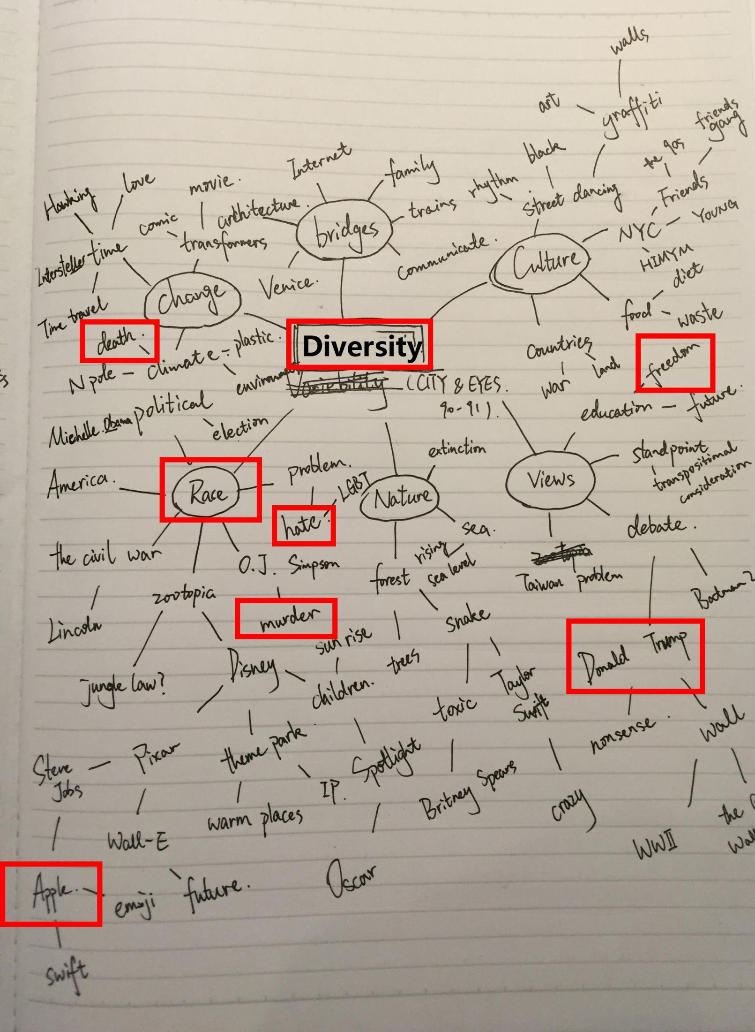
MIND MAP

Slide 4
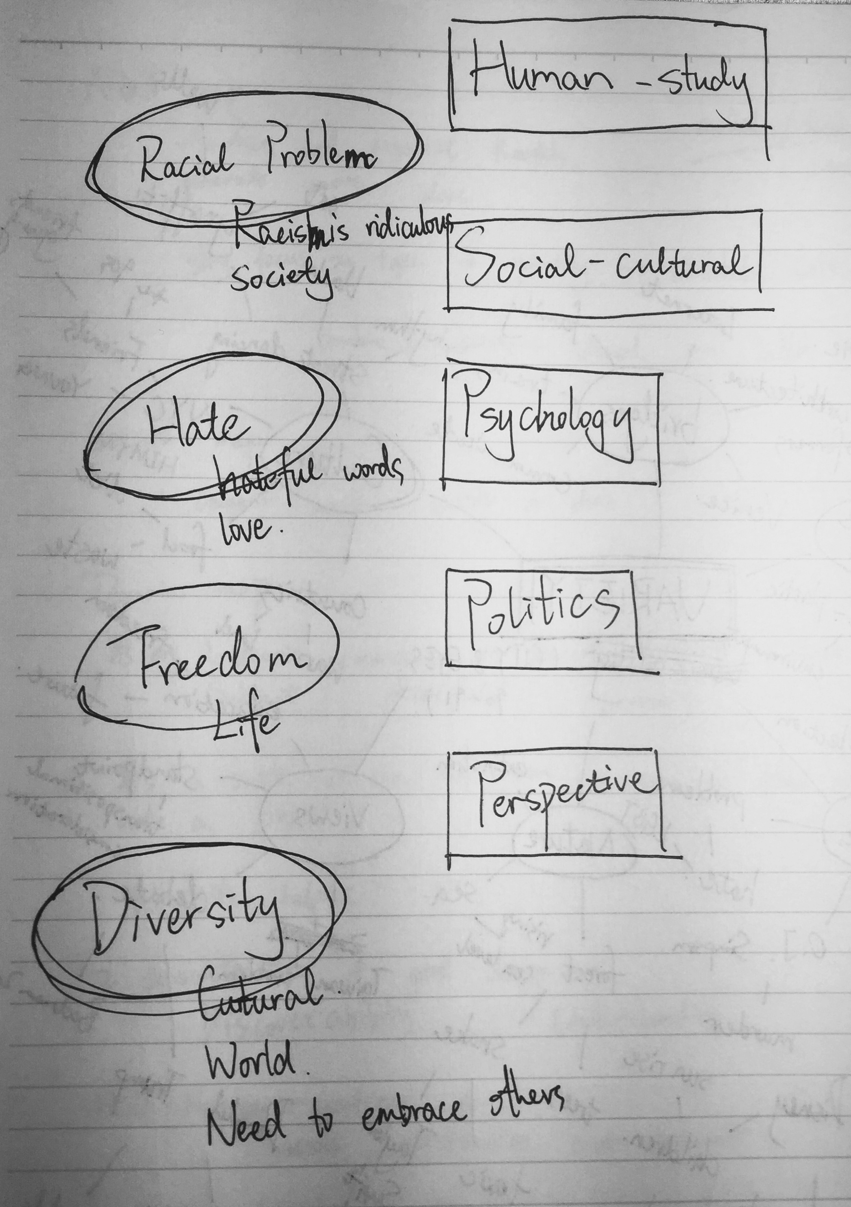
DOMAIN MAP

Slide 5
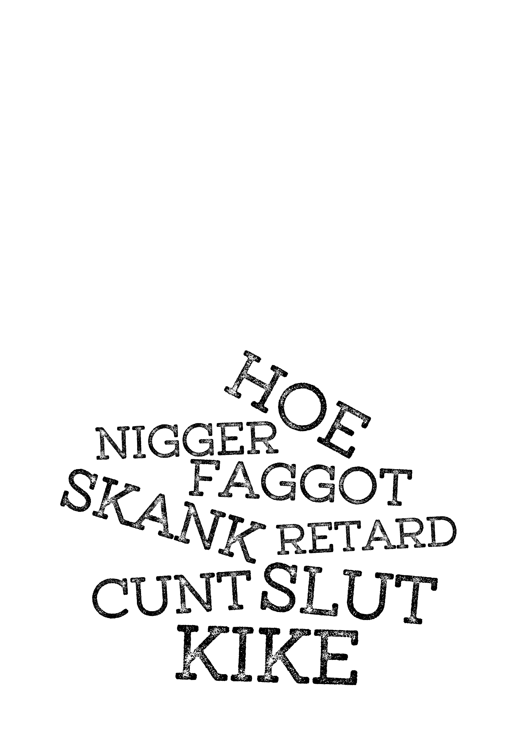
DOCUMENTATION

Slide 6
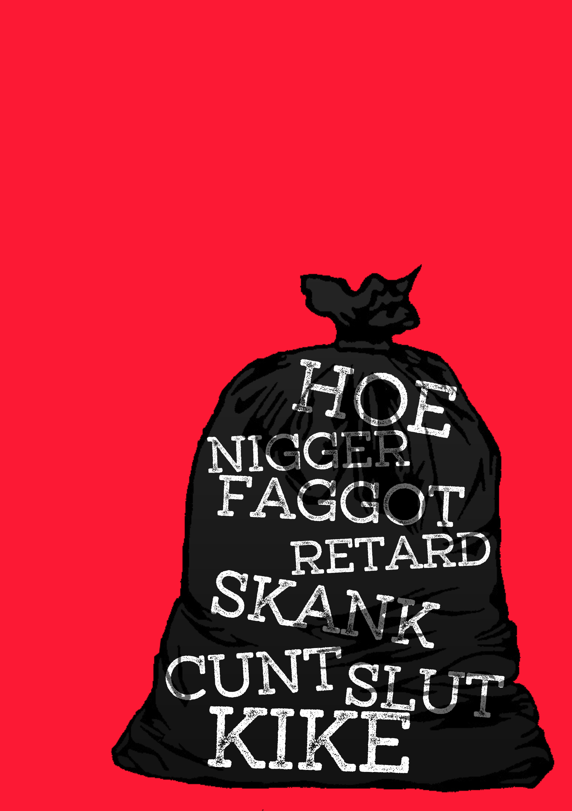
DOCUMENTATION

Slide 7
TOO SERIOUS? HERE'S A FUNNY ONE

Slide 8
RACE IPHONE
I MADE IT RACIST ON PURPOSE. I WANT CONVEY THE IDEA THAT RACISM IS PRETTY RIDICULOUS.

Slide 9
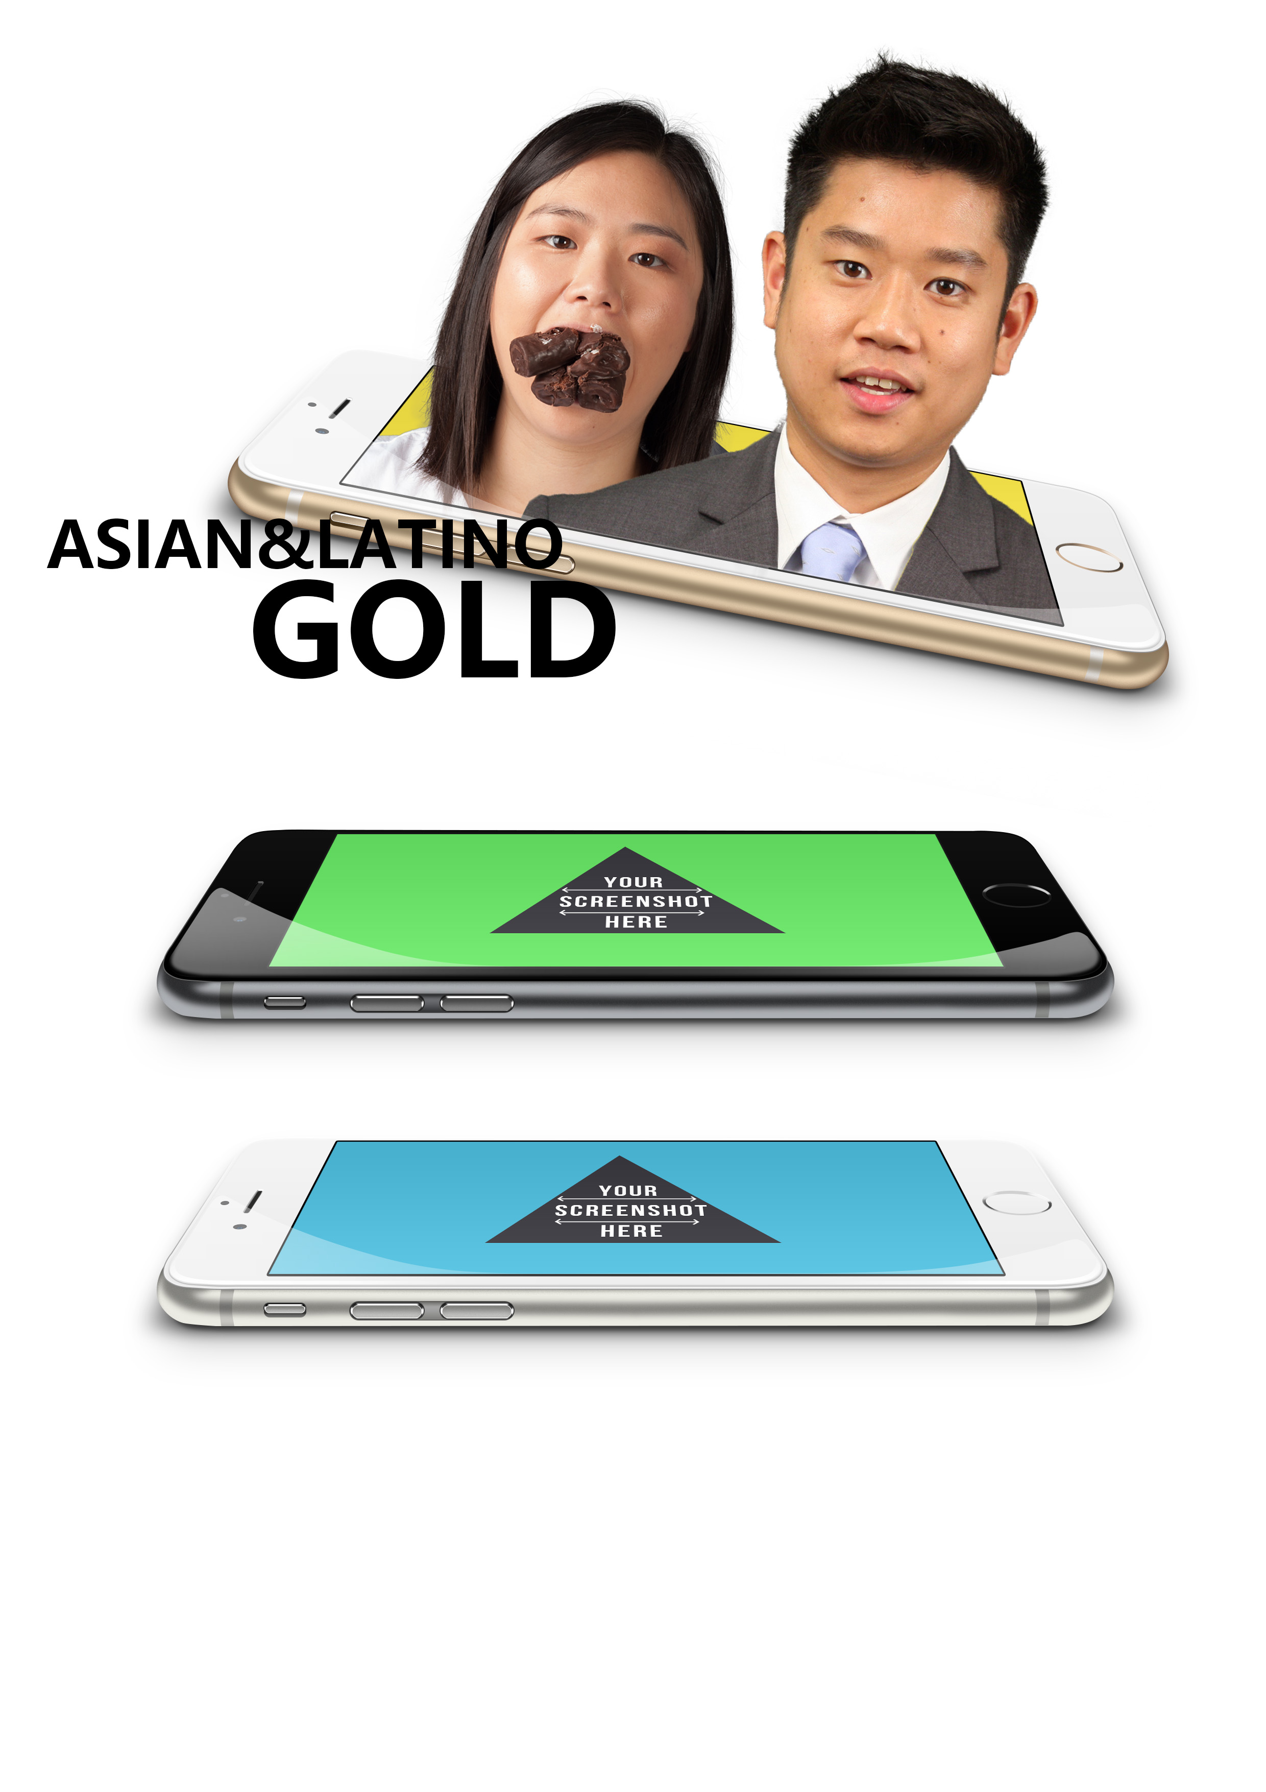
DOCUMENTATION

Slide 10
PRODUCT

